Slide 1
Practical no: 2
REPRESENATION OF DATA

Slide 2
Data Entry in MATLAB
Data of AGE of 18 students of BSCS class v=[21,22,22,23,25,24,24,22,23,25,20,21,25,24,23,22,21,25]

Slide 3
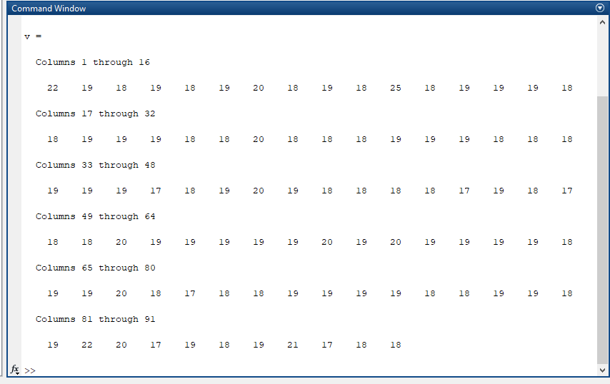
M. Amas Waseem

Slide 4
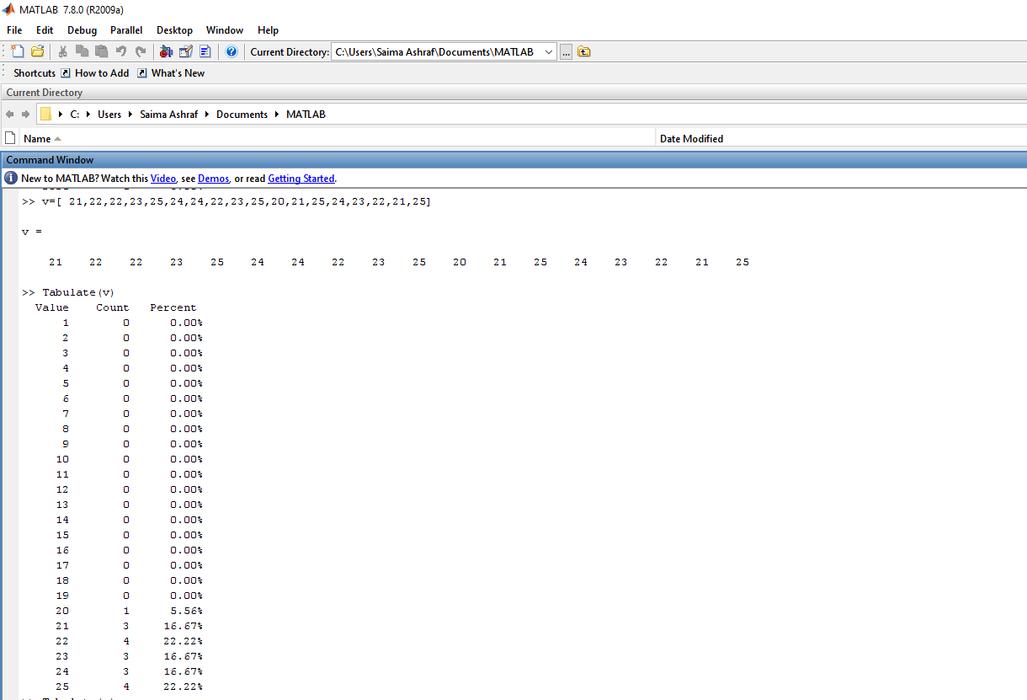
Ungrouped Frequency Or Relative Frequency Distribution
Command: Tabulate(v)

Slide 5
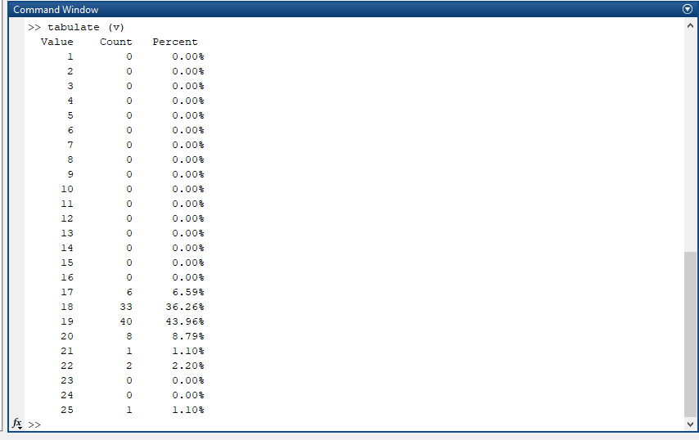
M. Amas Waseem

Slide 6
Grouped Frequency Distribution
Command: L=min value: size of C.I:max value+1
Command: histc(name of variable, lower limit)
L=20:1:26;
F=histc(v,L);

Slide 7
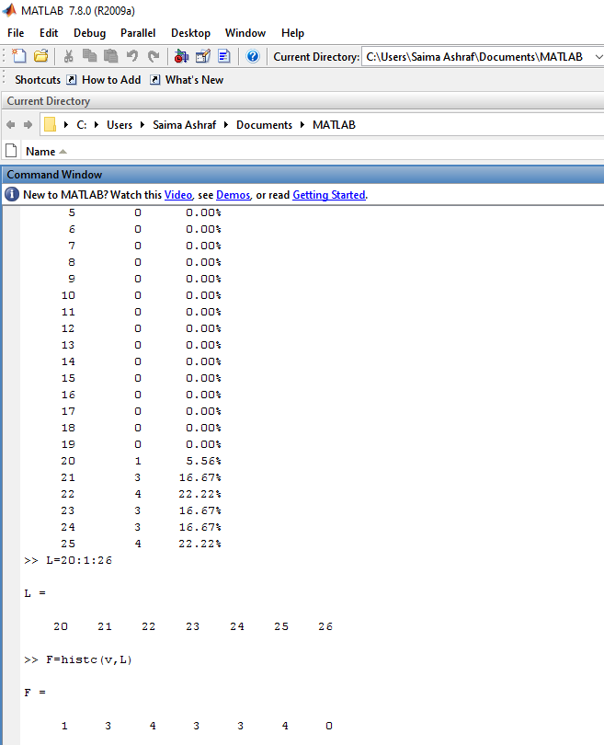
Output

Slide 8

M. Amas Waseem

Slide 9
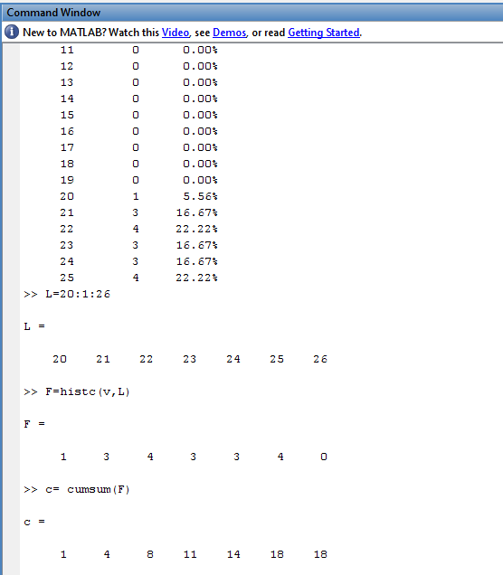
Cumulative Frequency Distribution
Command: c= cumsum(F)

Slide 10
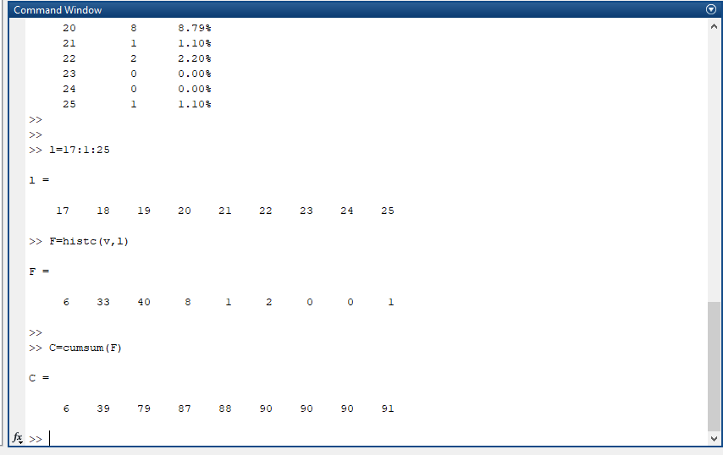
M. Amas Waseem

Slide 11
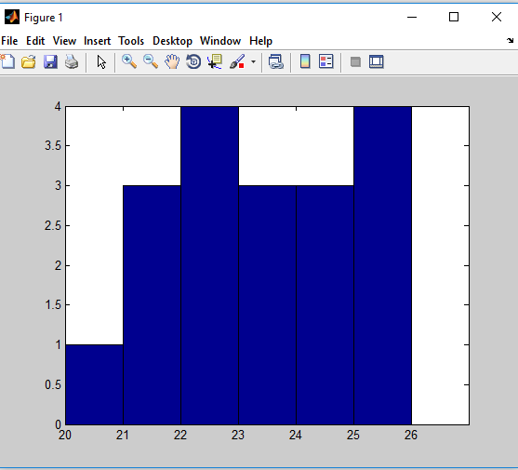
Graphs and Diagrams
Histogram: bar(L,F,'histc')

Slide 12
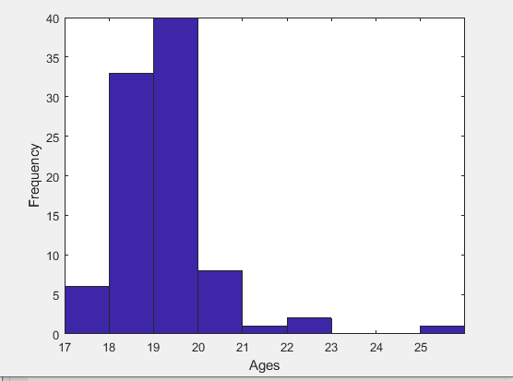
M. Amas Waseem

Slide 13
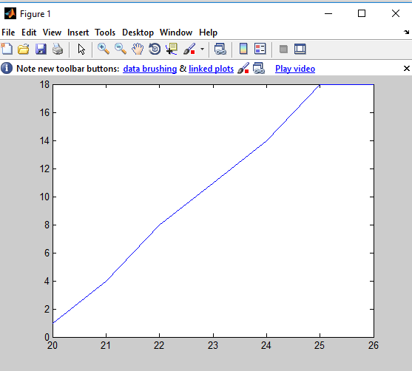
Graphs and Diagrams
Ogive: plot(L,c)

Slide 14
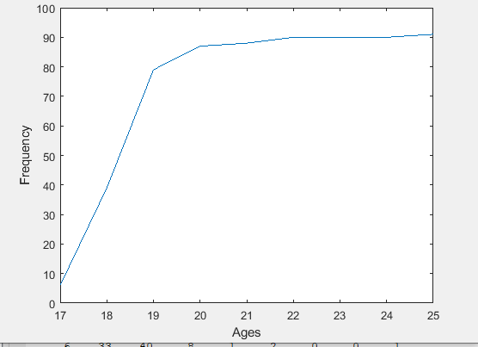
M. Amas Waseem

Slide 15
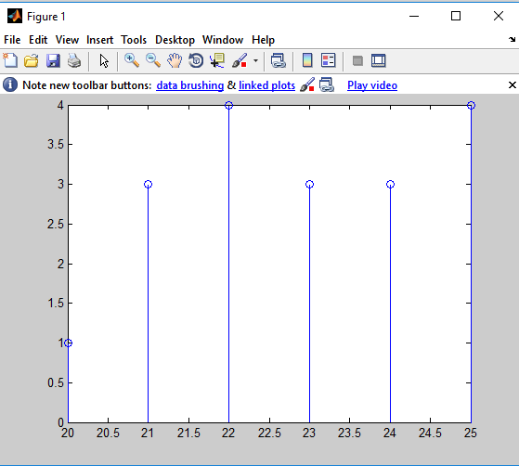
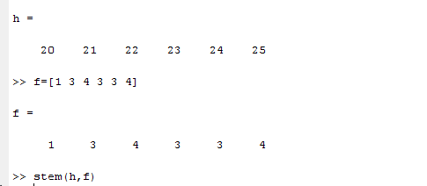
Graphs and Diagrams
Steam and Leaf Plot: stem(h,f)

Slide 16
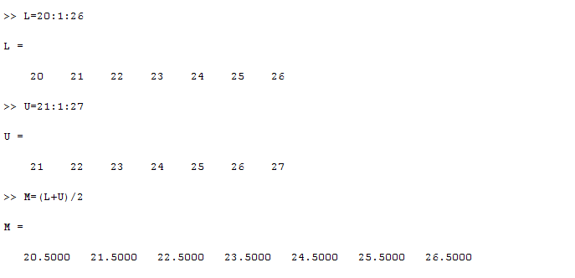
Mid points

Slide 17
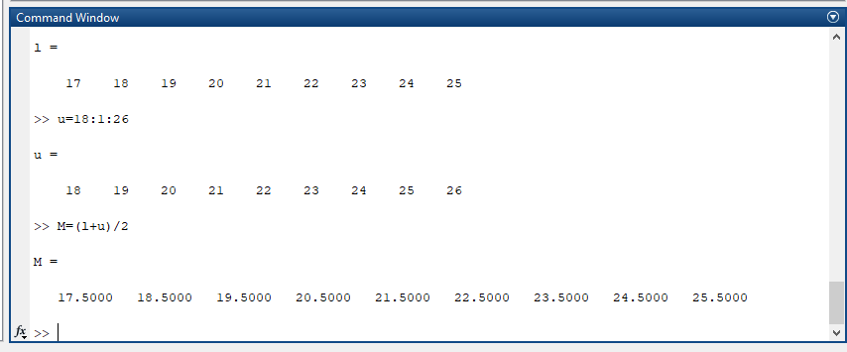
M. Amas Waseem

Slide 18
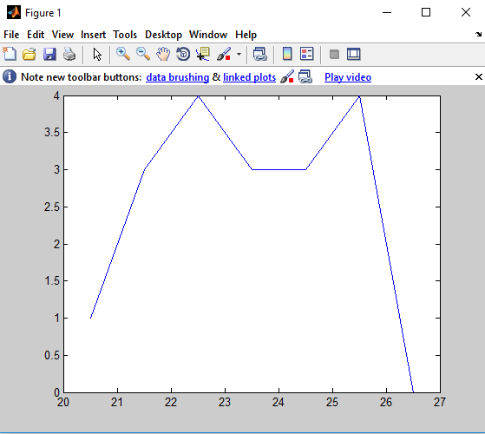
Frequency curve and polygon
Command: plot(M,F)

Slide 19
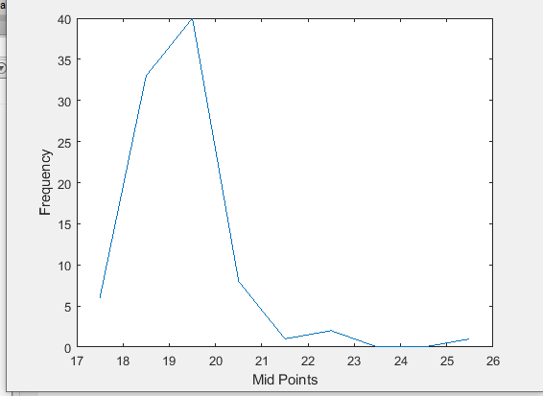
M. Amas Waseem

Slide 20
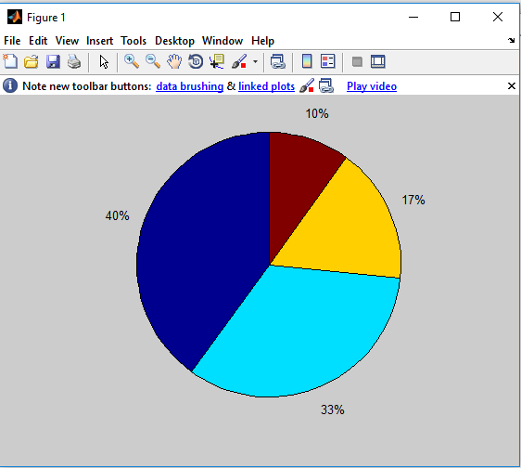
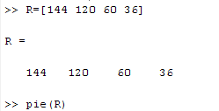
Graphs and Diagrams
Command: pie(R)

Slide 21
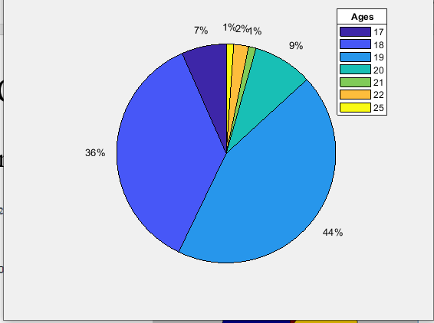
M. Amas Waseem

Slide 22
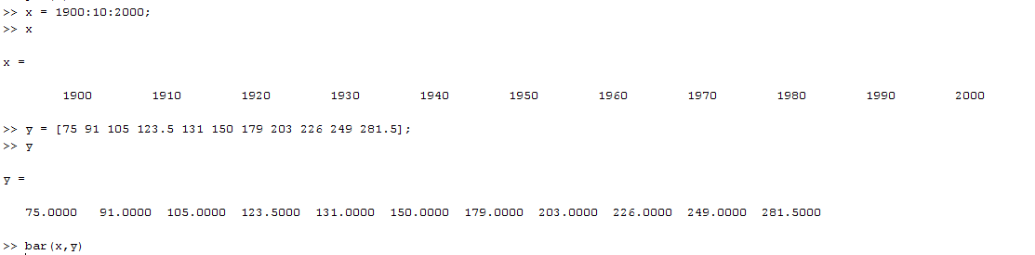
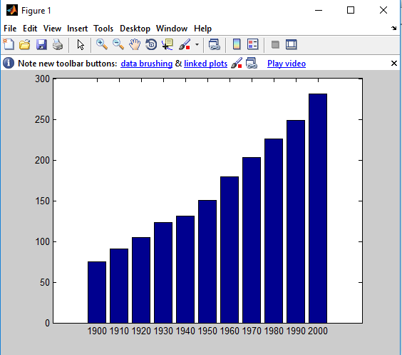
Graphs and Diagrams
Command: bar(x,y)

Slide 23
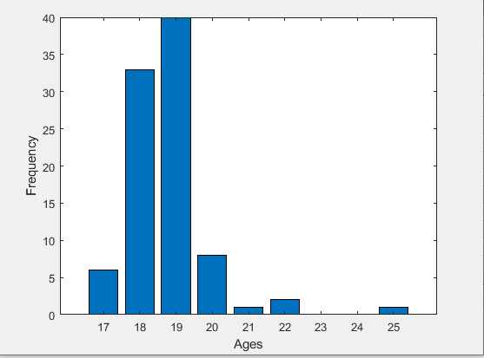
M. Amas Waseem

Slide 24
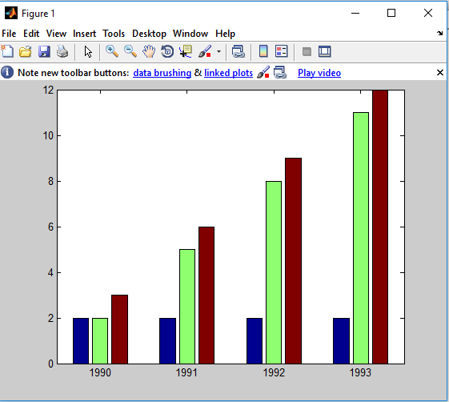
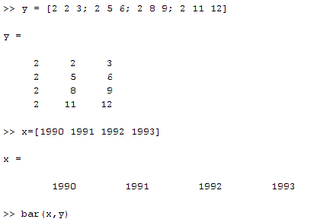
Multiple Bar Diagram
Command: bar(x,y)

Slide 25
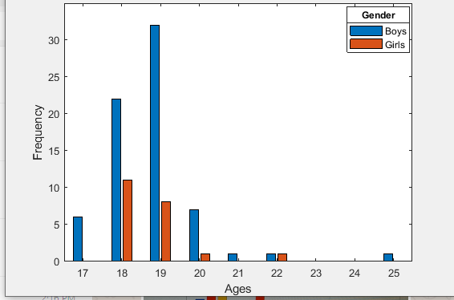
M. Amas Waseem

Slide 26
Assignment Question
Plot a sub-divided bar diagram and a Dot plot in MATLAB

Slide 27
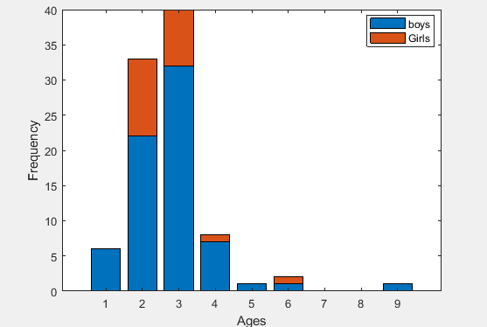
M. Amas Waseem

